Slide 1
Cac hinh thuong gap:
Tam giac vuong va duong cao
Tam giac noi tiep ½ duong tron va tiep tuyen
Goc co canh tuong ung vuong goc (2 goc can nhau

Slide 2
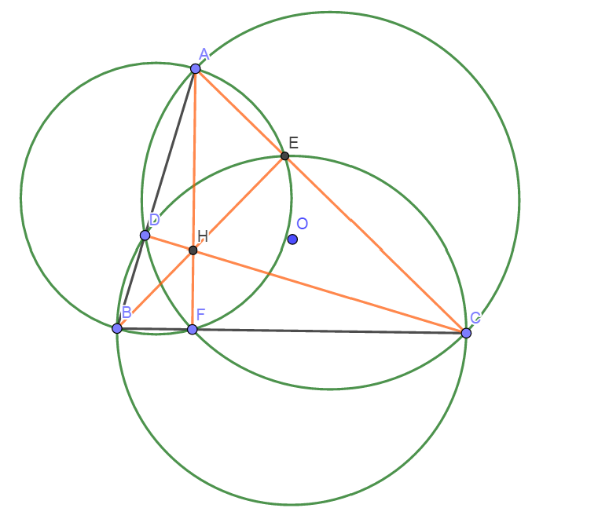
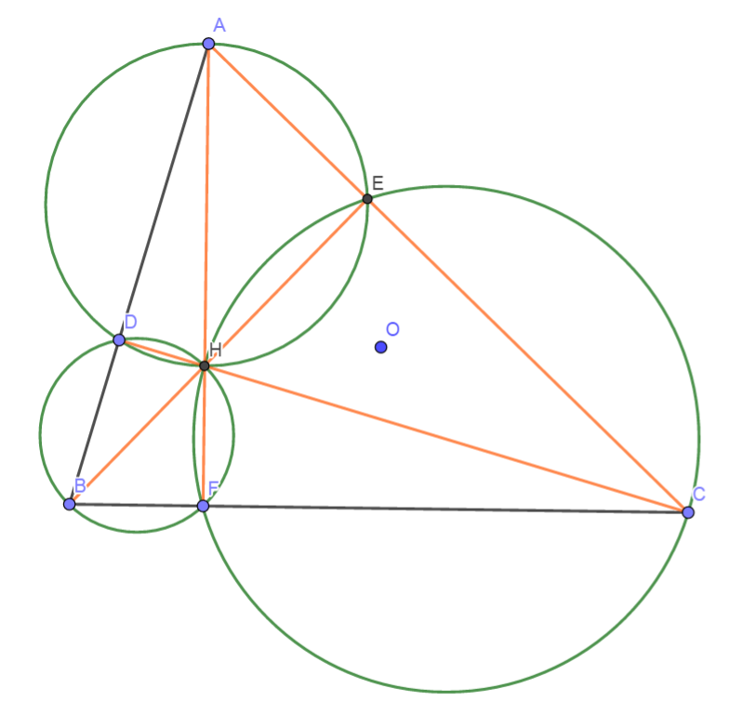
Truc Tam: 6 tu giac noi tiep

Slide 3
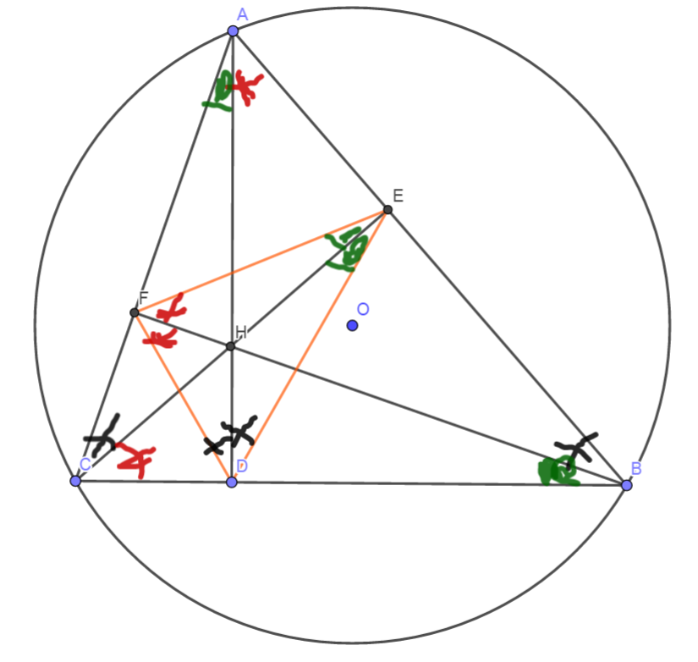
Truc tam: Tinh chat chan 3 duong cao
Chan 3 duong cao tao thanh tam giac DEF
3 duong cao cua tam giac ABC cung la 3 duong phan giac cua tam giac chan duong cao (DEF)
3 tam giac nho o 3 dinh (3 cai banh u) dong dang voi tam giac lon

Slide 4
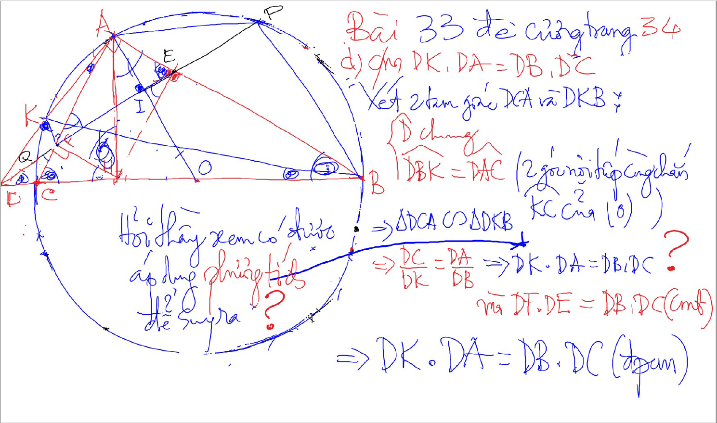
C/m tam giac dong dang truong hop 2

Slide 5
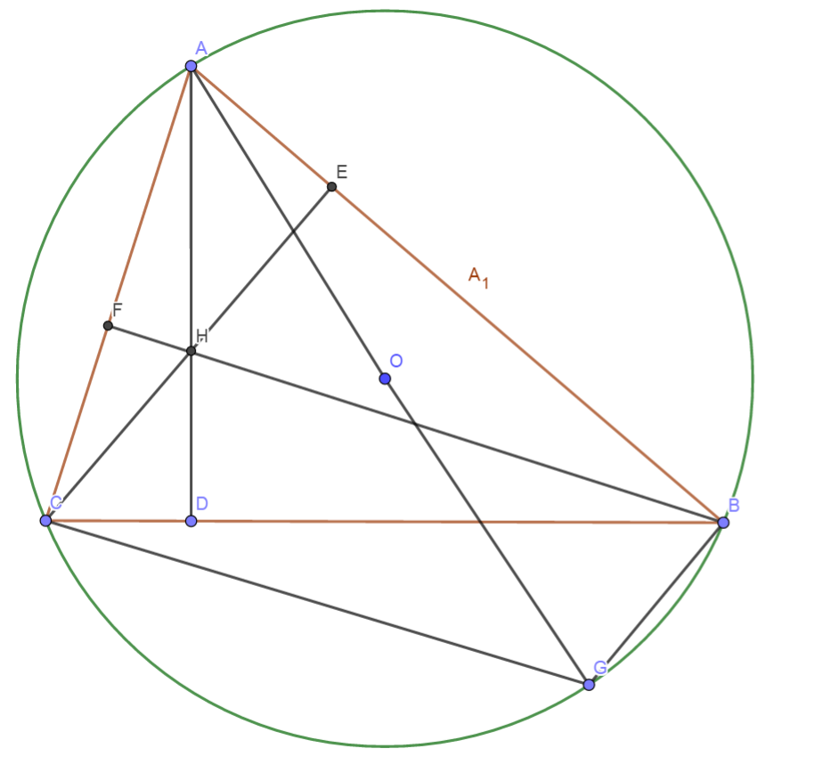
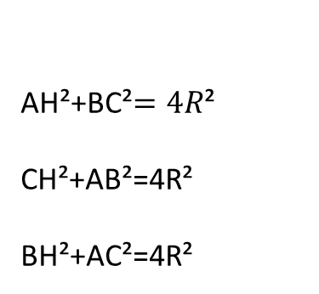
Truc Tam: Quan he giua canh day va khoang cach den truc tam
AH²+BC²$=4R$²
CH²+AB²=4R²
BH²+AC²=4R²

Slide 6
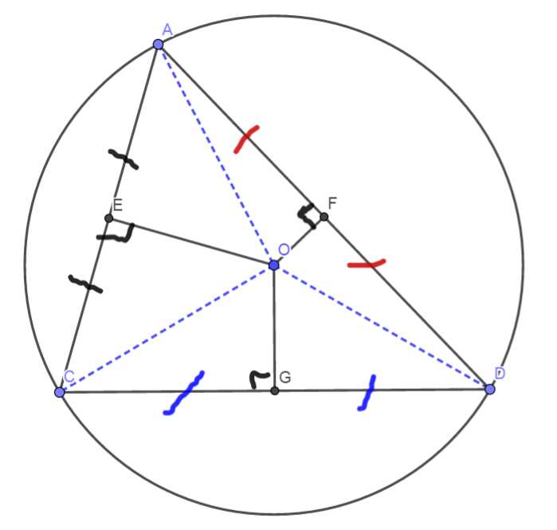
3 duong trung truc dong qui, la tam cua duong tron ngoai tiep tam giac
Giao diem cua 3 duong phan giac la tam duong trong noi tiep tam giac

Slide 7
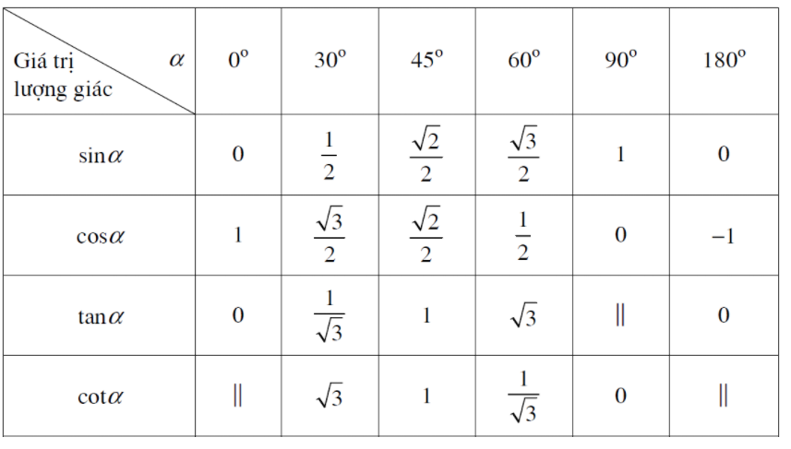
Bang luong giac cac goc thong dung

